Slide 1
Machine Learning in Research of Eyes
Prepared by: Kossov Assylbek
Bektemirova Aruzhan
Kassanov Roman

Slide 2

The current problem
The lack of research in brain eye relationship

Slide 3
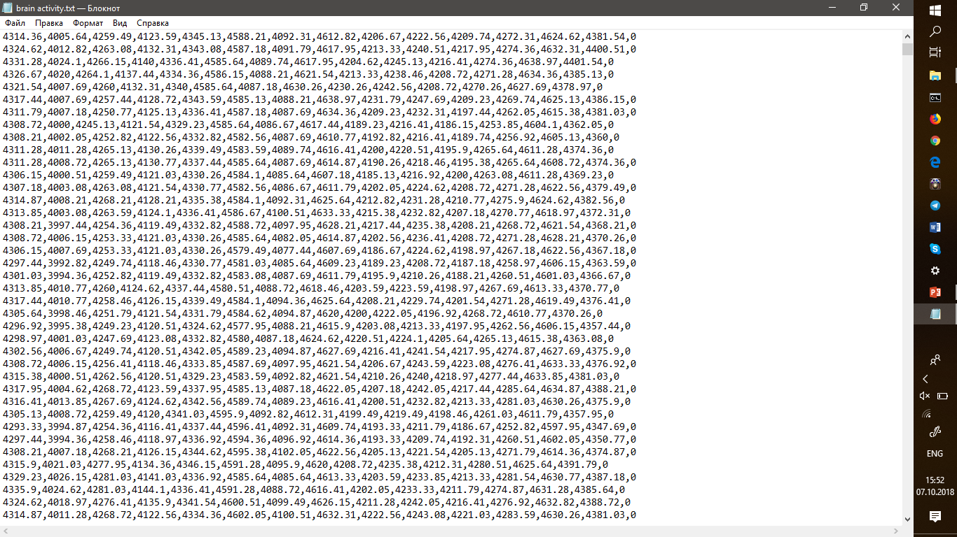
DATASET
Consists from coordinates of brain signals

Slide 4
Competitors
University of Massachusetts
Harvard Medical School
Stanford Medical School
Boston University of Medicine
And etc…………..

Slide 5
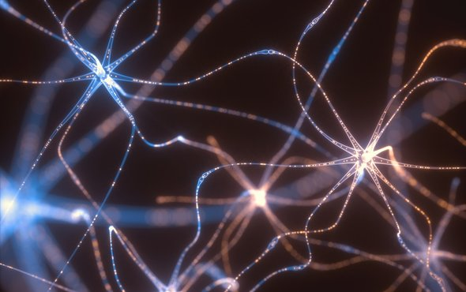
How to Predict Whether a Persons Eyes are Open or Closed Using Brain Waves

Slide 6
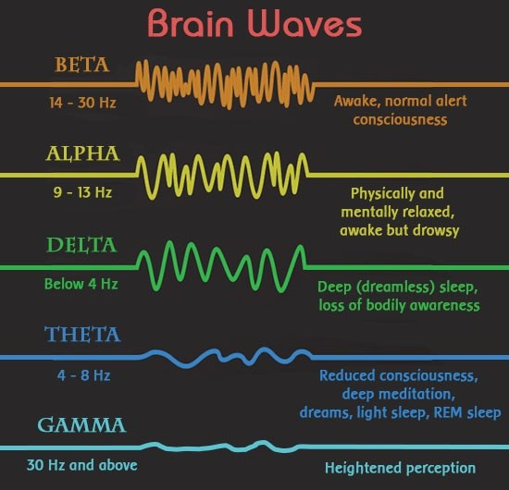
Types of waves

Slide 7
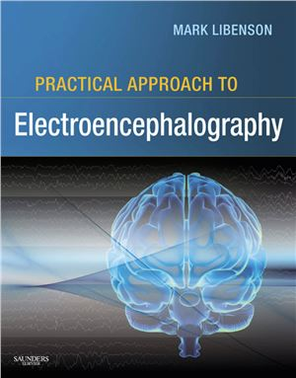
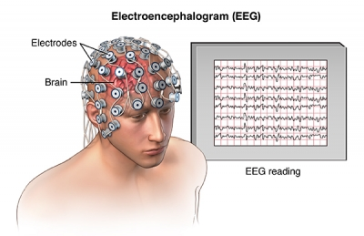
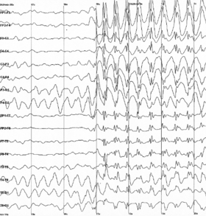

Slide 8
Thank you !!!
IT’S TIME FOR QA

